Slide 1

Stephen Vincent Mather, GIS Manager, Cleveland Metroparks
@smathermather, svm@clevelandmetroparks.com

Slide 2
OpenDroneMap is an open source toolkit for aerial drone imagery.
It is modern photogrammetry - fully automated matching, digital surface modeling, and mosaicking

Slide 3
In preparation for the robot takeover.

Slide 4
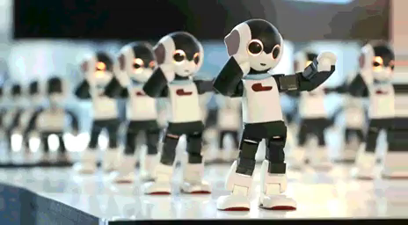
Preparation for the Robot Takeover
Why?
https://imgur.com/gallery/azyruE3

Slide 5
The Future

Slide 6
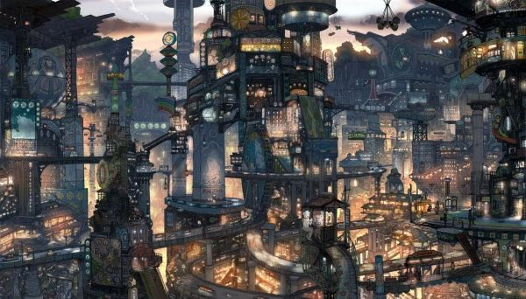
https://s-media-cache-ak0.pinimg.com/736x/61/f0/37/61f037cb982dbd3d9720a107e9373b01.jpg

Slide 7
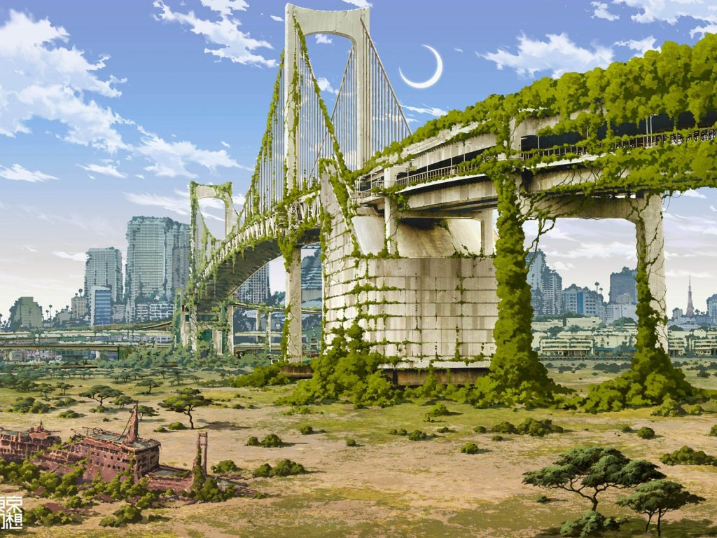
https://www.walldevil.com/6554-bridges-cities-crescent-moon-fantasy-futuristic-japan-landscapes-moss-nature-postapocalyptic-rainbow-bridge-ruins-ships-tokyo-tokyogenso-vehicles.html

Slide 8
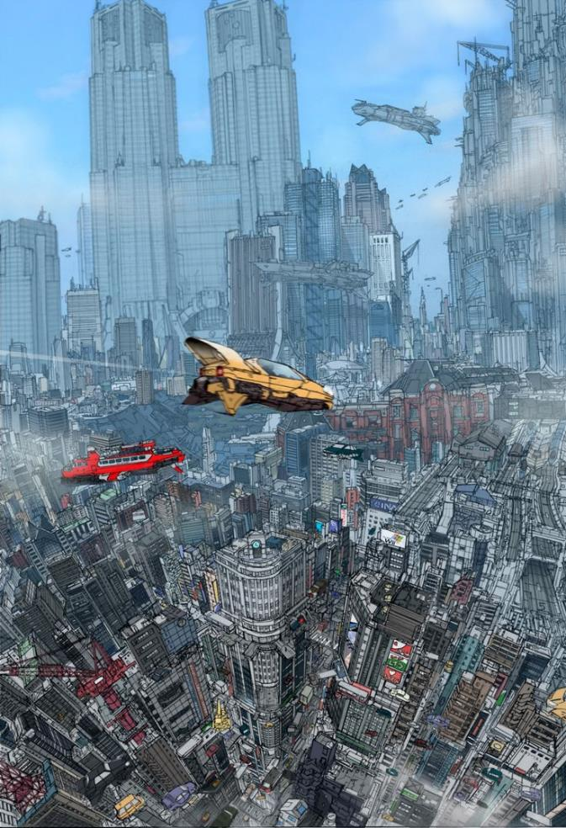
https://s-media-cache-ak0.pinimg.com/736x/36/a5/e7/36a5e797df79b8ed4931d40dc75c0084.jpg

Slide 9
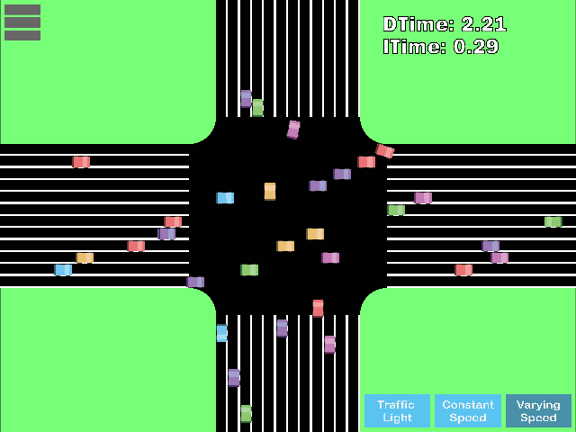

Slide 10
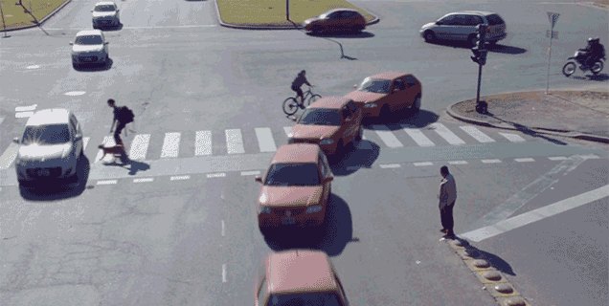

Slide 11
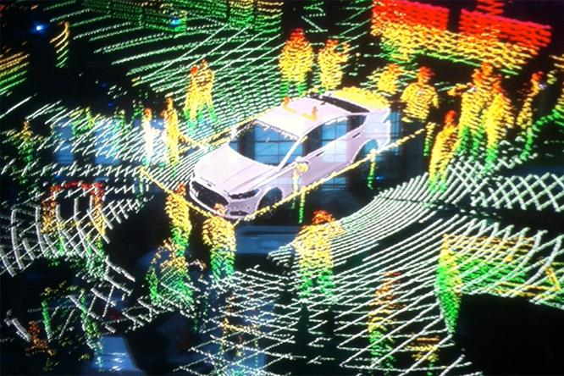

Slide 12
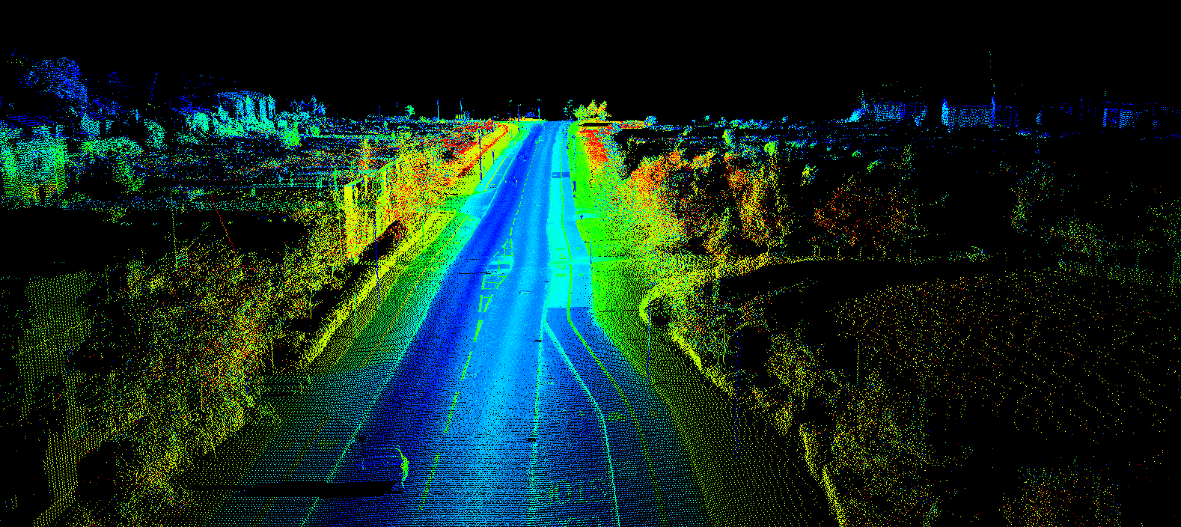
http://www.renishaw.com/media/img/gen/9a5511617ef7479a8d3ddc0917dc5b6d.png

Slide 13

OpenDroneMap is an open source toolkit for aerial drone imagery.
It is modern photogrammetry - fully automated matching, digital surface modelling, and mosaicking
Platform vs. Toolkit

Slide 14
Origins
Computer Vision
Photogrammetry
Notes:
OpenDroneMap originates from Computer Vision, i.e. how do we enable computers to navigate and understand the world.
It depends on stereo vision much like we do to make sense of the world in 3D

Slide 15
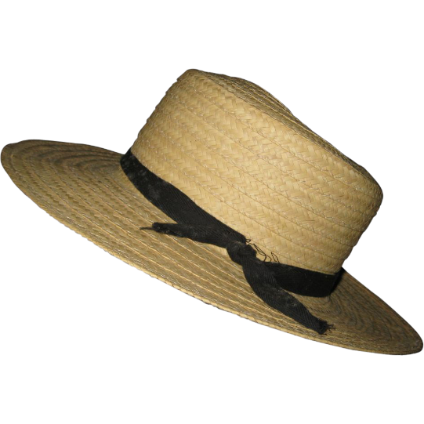
Purposes
Ecology
Humanitarian
Participatory creation of data for the public good
http://image0-rubylane.s3.amazonaws.com/shops/suzanstreasures/VCx20-x201402.1L.jpg
Notes:
OpenDroneMap originates from Computer Vision, i.e. how do we enable computers to navigate and understand the world.
It depends on stereo vision much like we do to make sense of the world in 3D

Slide 16
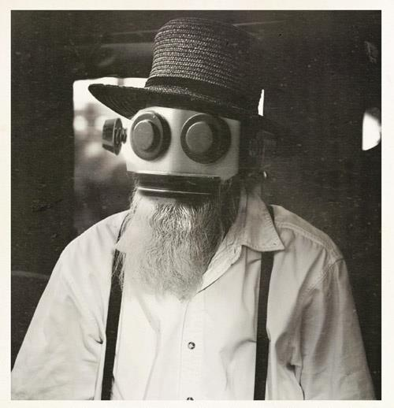
This complicates my robot narrative…
https://s-media-cache-ak0.pinimg.com/736x/a7/9a/73/a79a731eea0f09d09c012856914e74dc.jpg

Slide 17
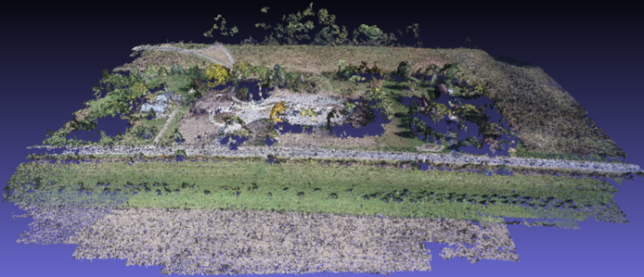
Point Cloud from Matching
Notes:
(Photogrammetrically Derived Point Cloud)

Slide 18
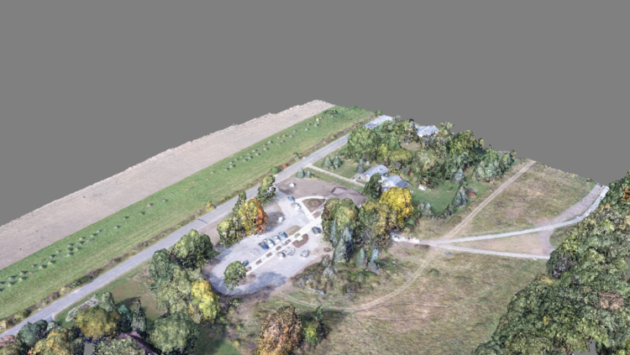
Dense Point Cloud from finding all matches

Slide 19
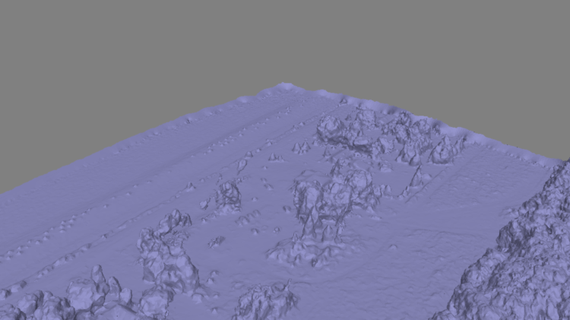
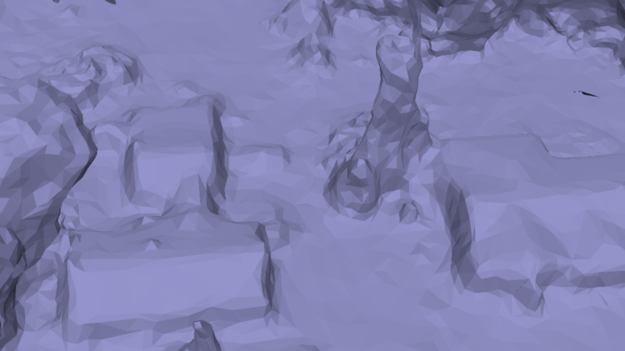
Mesh
Notes:
Uses the Point Cloud Library (PCL), followed by mesh decimation

Slide 20
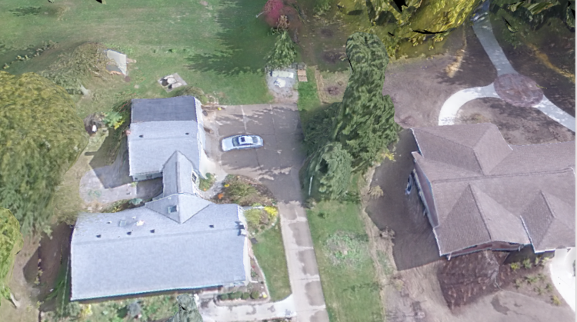
Texturing

Slide 21
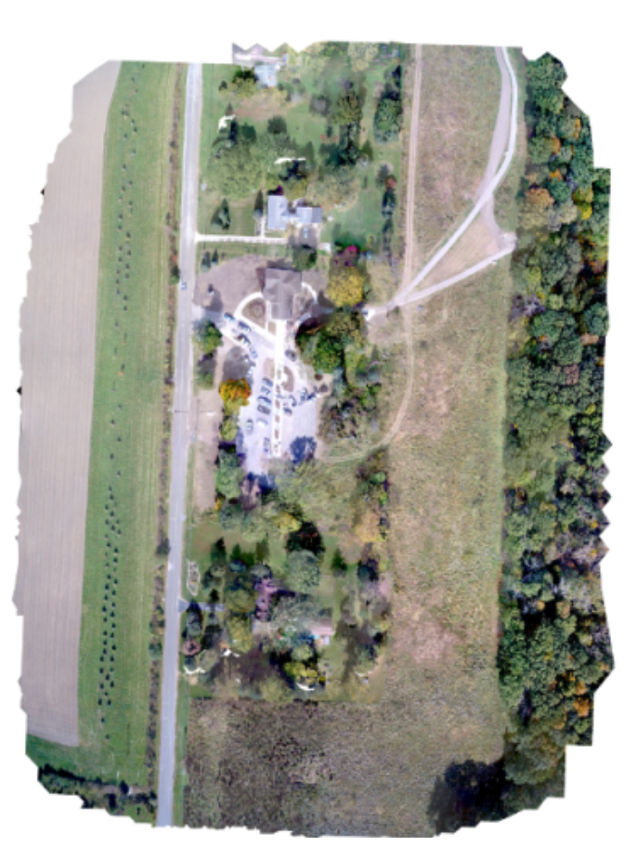
Orthophoto Generation

Slide 22
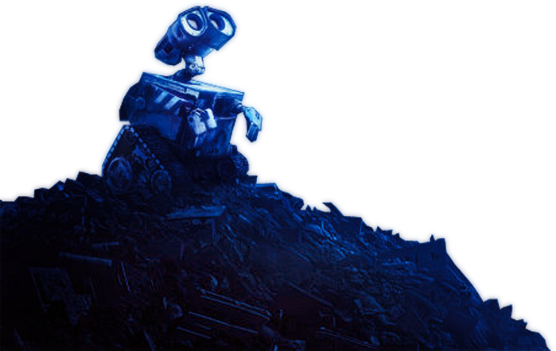
Questions you may be asking:
This is great, Steve. How do I get started in collecting the necessary datasets for the robot takeover?
https://photoshopstar.com/graphics/wall-e-cartoon-style-wallpaper/

Slide 23
How to Use OpenDroneMap

Slide 24
Installation
Natively using Ubuntu 14.04 or later (or with Virtual Machine via vagrant)
Linux, MacOS or Windows, by installing Docker
Windows WebODM installer
See project: WebODM.org

Slide 25
Usage
Command line tool
Portable OpenStreetMap (POSM)
WebODM
GUI
API
API Docs: https://opendronemap.github.io/WebODM/

Slide 26
Funding and Future

Slide 27
Funding
Cleveland Metroparks
American Red Cross
Integration with Portable OpenStreetMap (POSM)
Humanitarian Innovation Fund
Make ODM Easier to Use
Make the products from it better / more accurate
World Bank Tanzania
Zanzibar Mapping Initiative using ODM for processing imagery
Masserano Labs (In-kind)

Slide 28
OpenDroneMap: Future
Quality and robustness improvements
Scalability
Reduce memory footprint
Data Partitioning
Analysis
Add automated DTM extraction
Classification
Mesh improvements

Slide 29
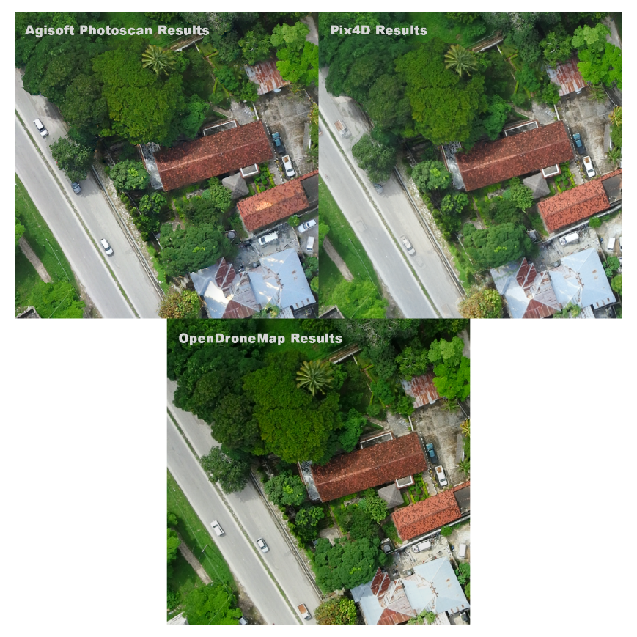
ODM Improvements

Slide 30
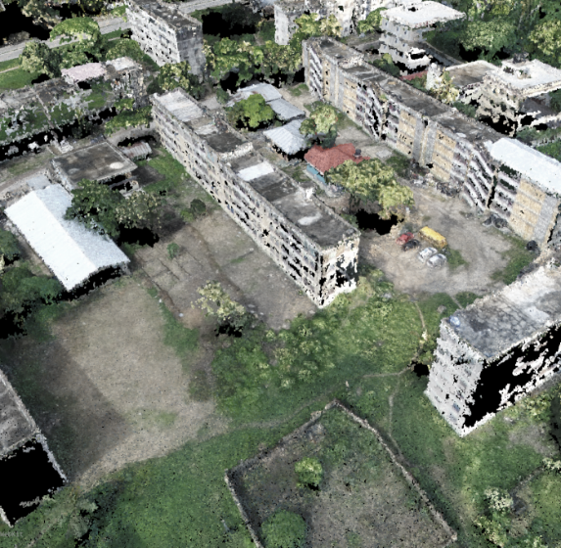
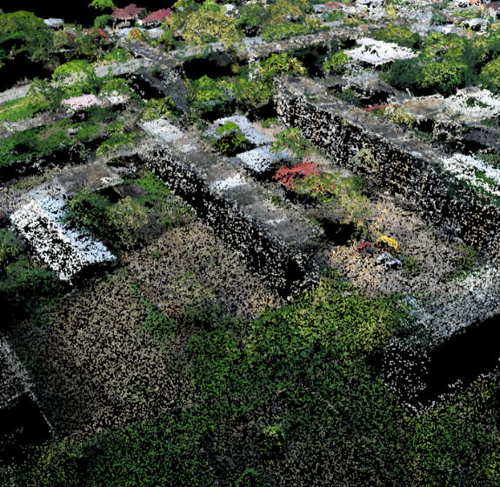
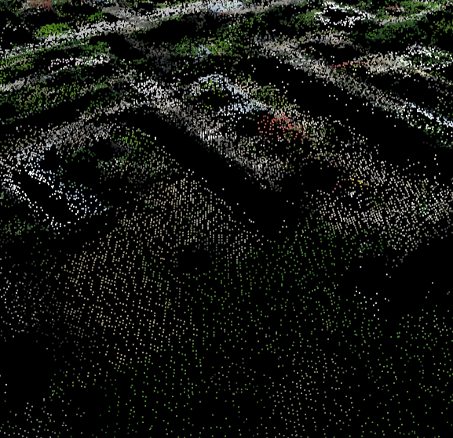
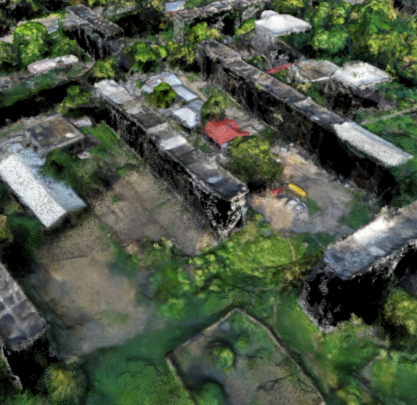
ODM Improvements
Agisoft Photoscan Point Cloud
Pix4D Point Cloud
Previous OpenDroneMap Point Cloud
OpenDroneMap Improved Point Cloud
OpenDroneMap Improved Point Cloud

Slide 31
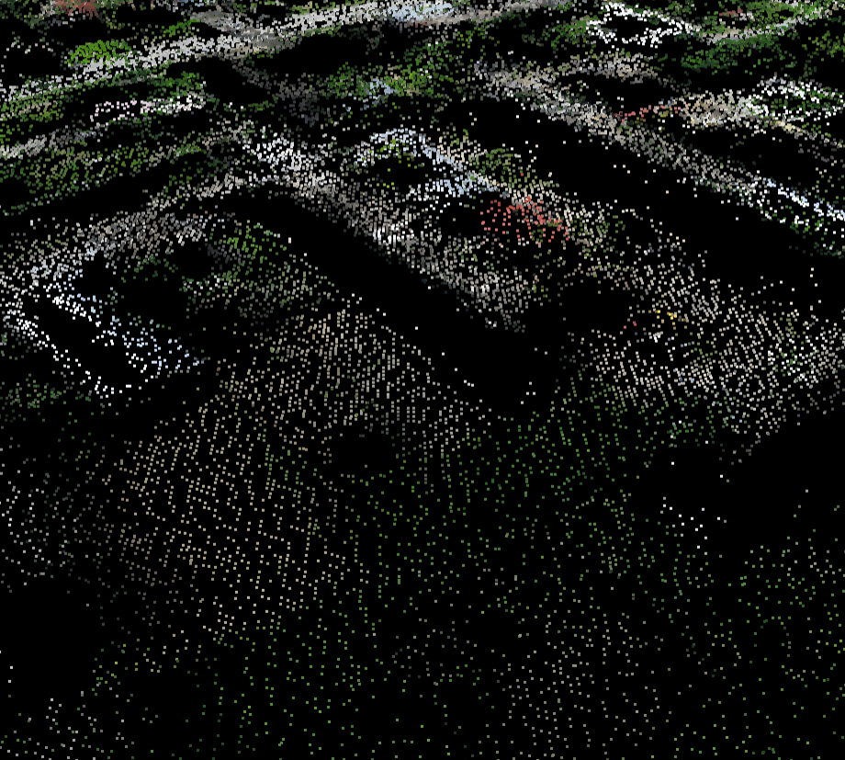

Previous OpenDroneMap Point Cloud
OpenDroneMap Improved Point Cloud

Slide 32
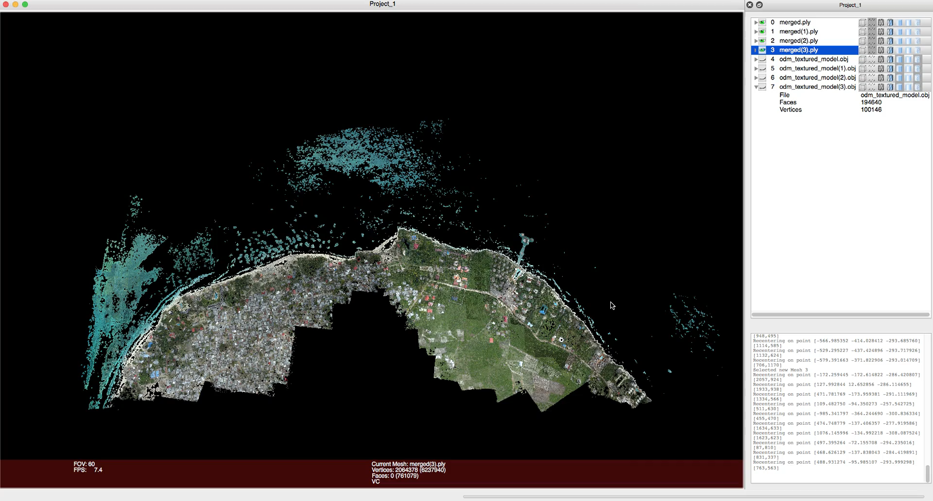

Slide 33
Questions

Slide 34
Stephen Mather, GIS Manager, Cleveland Metroparks
@smathermather, svm@clevelandmetroparks.com

